Slide 1
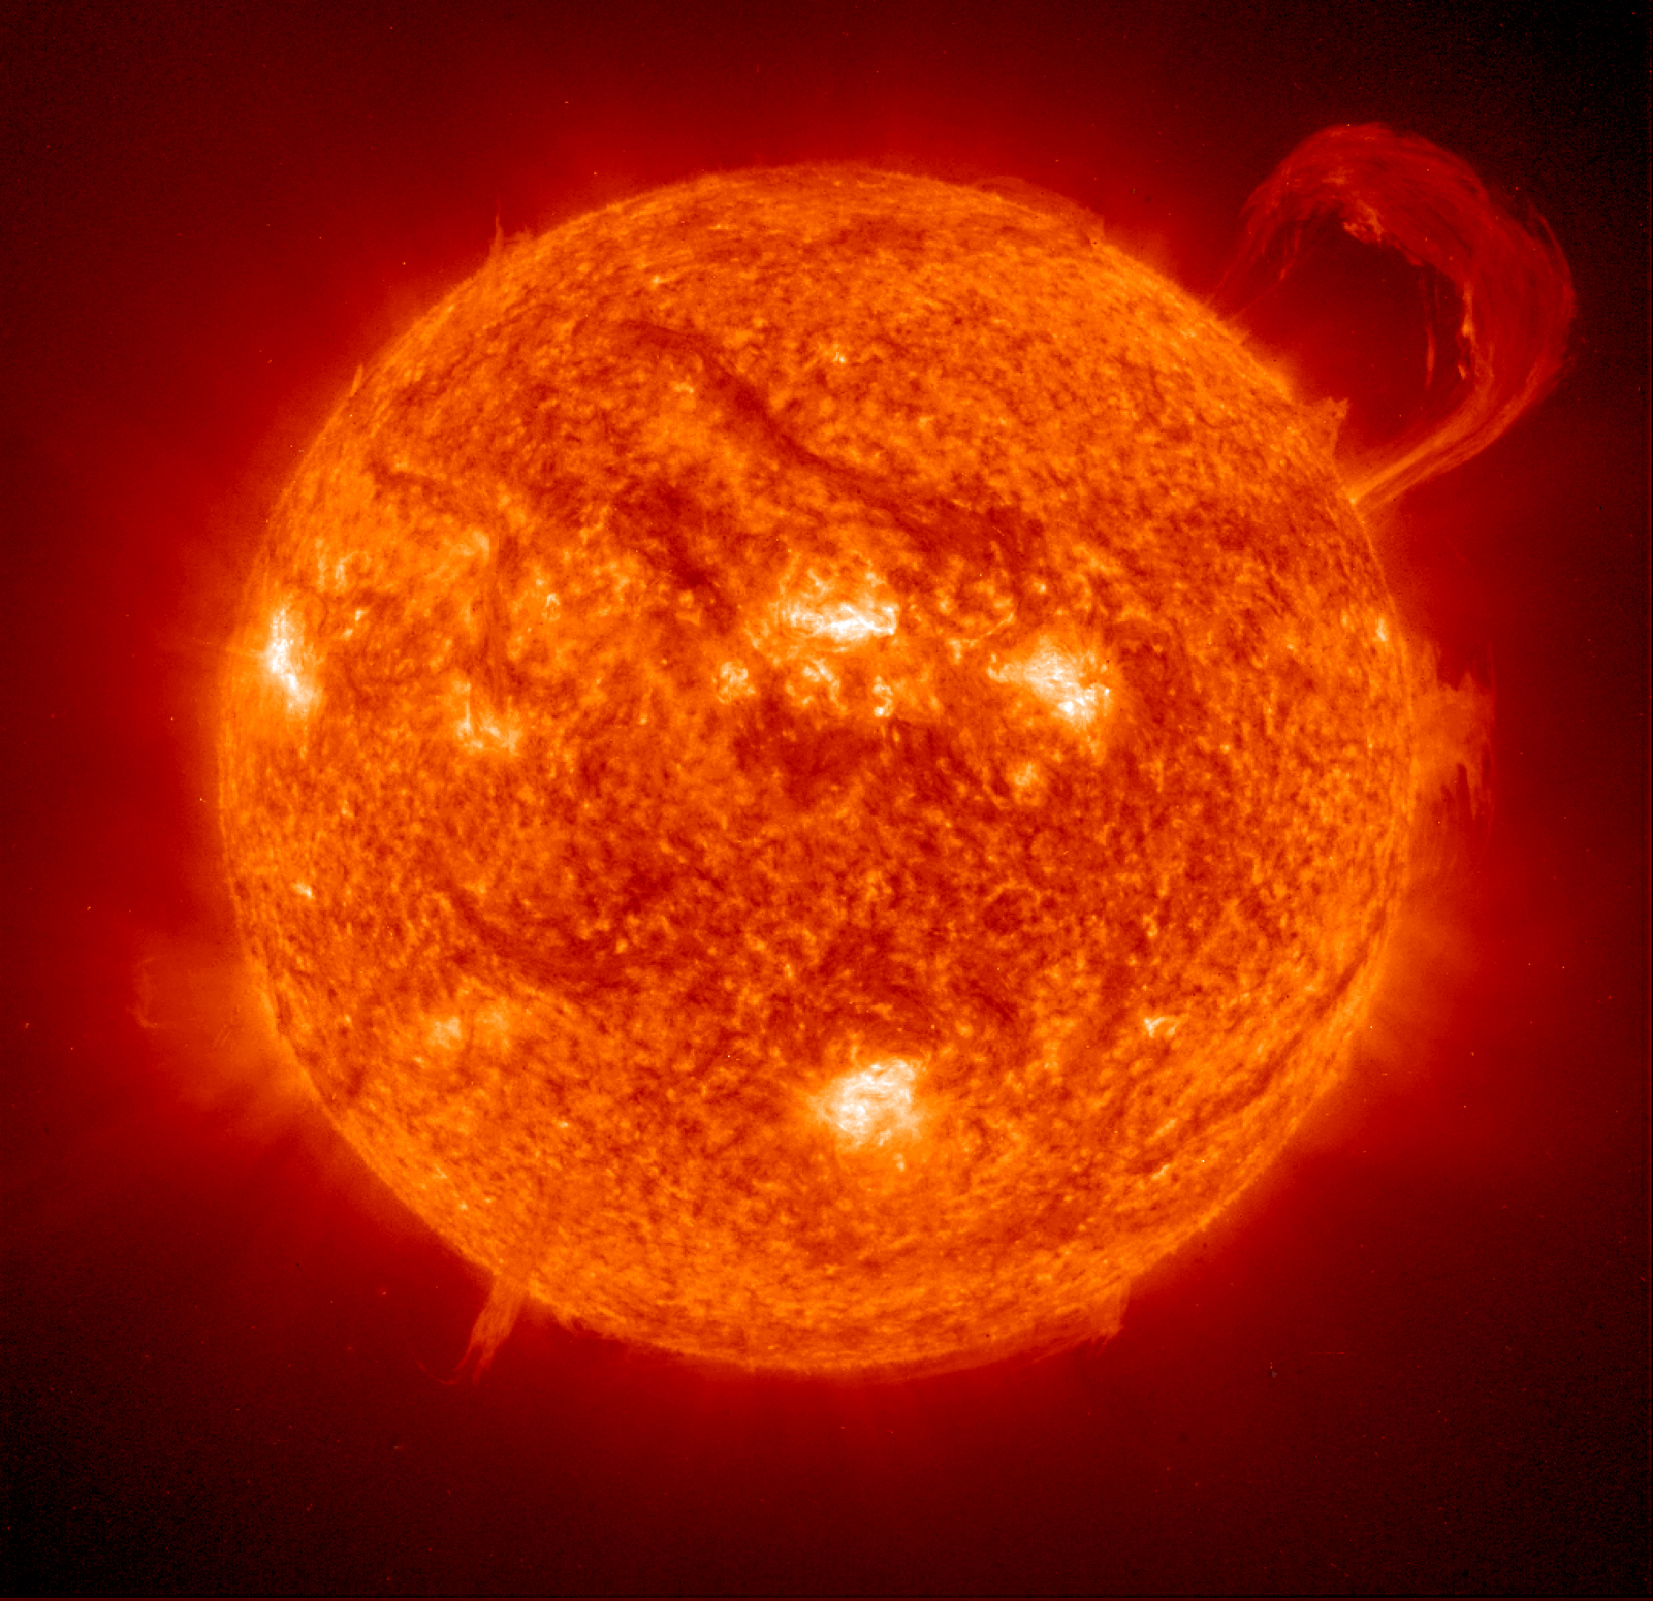
Peter Sebrechts
Summer Internship of
Peter Sebrechts
Dr. Rabin
Dr. Doug Rabin
Building 21

Slide 2
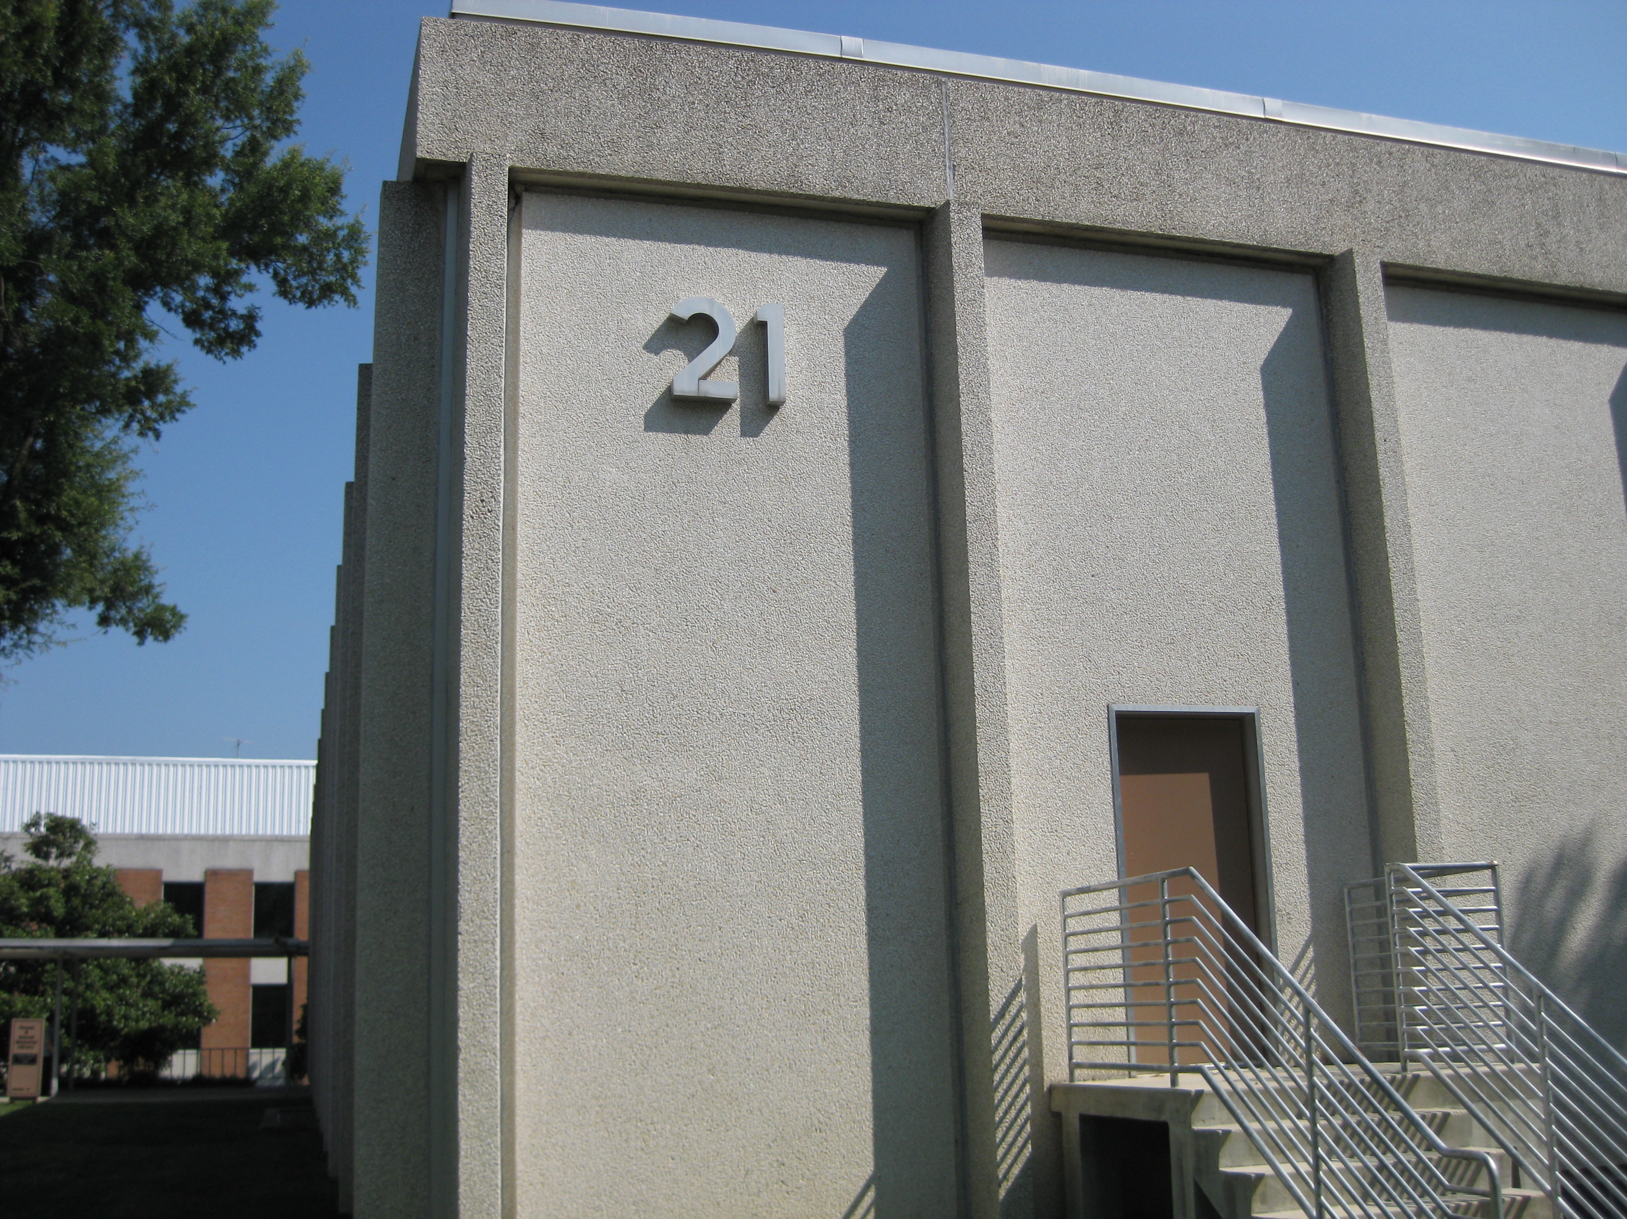
What I did this summer
-Mapping of Eunis Data Reduction
-Identifying Wavelengths of the Sun
-Other Goddard Experiences

Slide 3
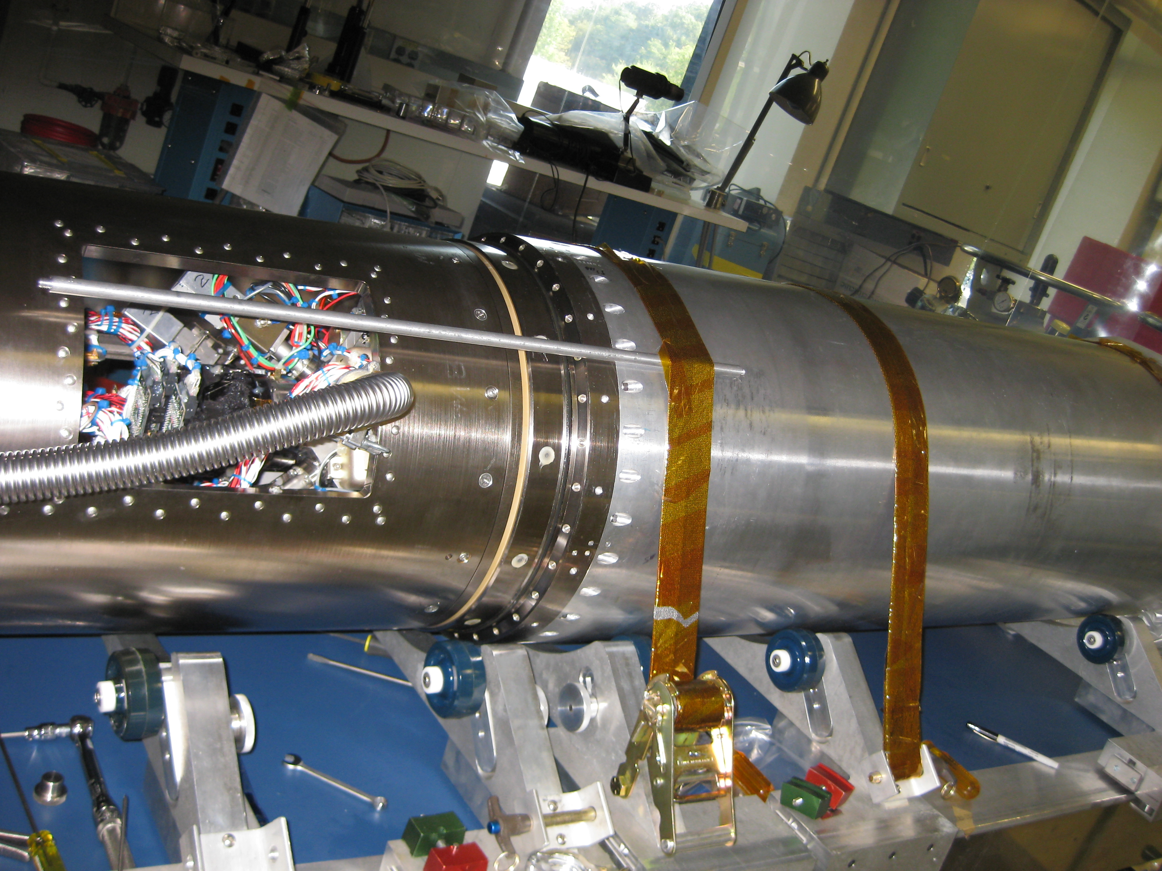
What is Eunis?
“Extreme Ultraviolet Normal Incidence Spectrograph”
It is a suborbital sounding rocket that takes extreme ultraviolet images of the sun.
At Wavelengths of:
-Short wavelength(170 to 205 Angstroms)
-Long wavelength (300 to 370 Angstroms)
Exposure times of: .1s, .5s, 1s, and 4.1s

Slide 4
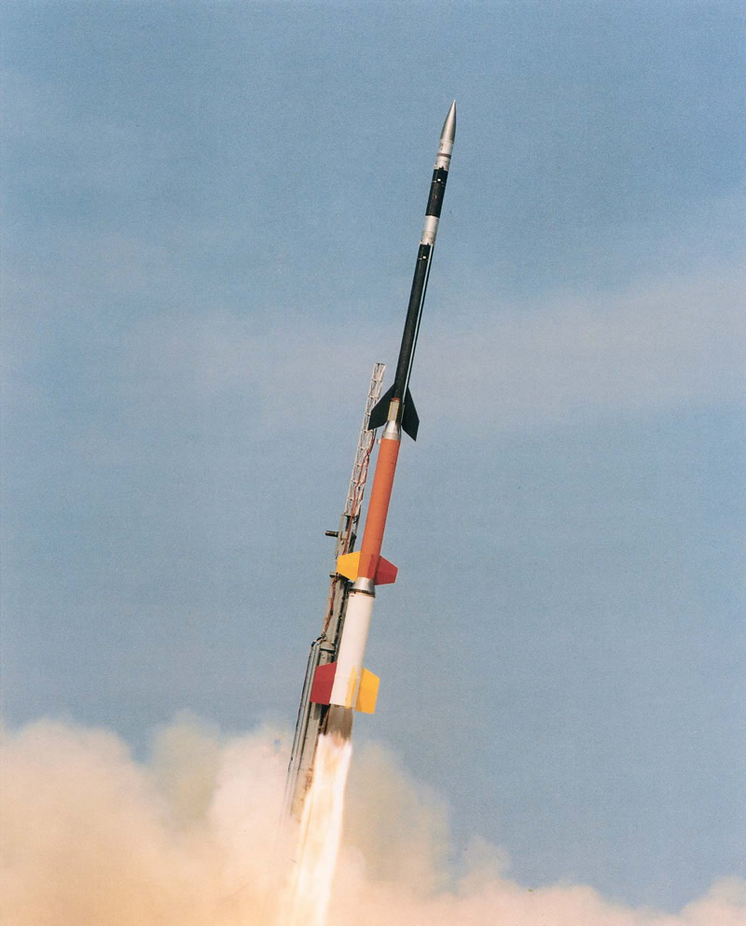
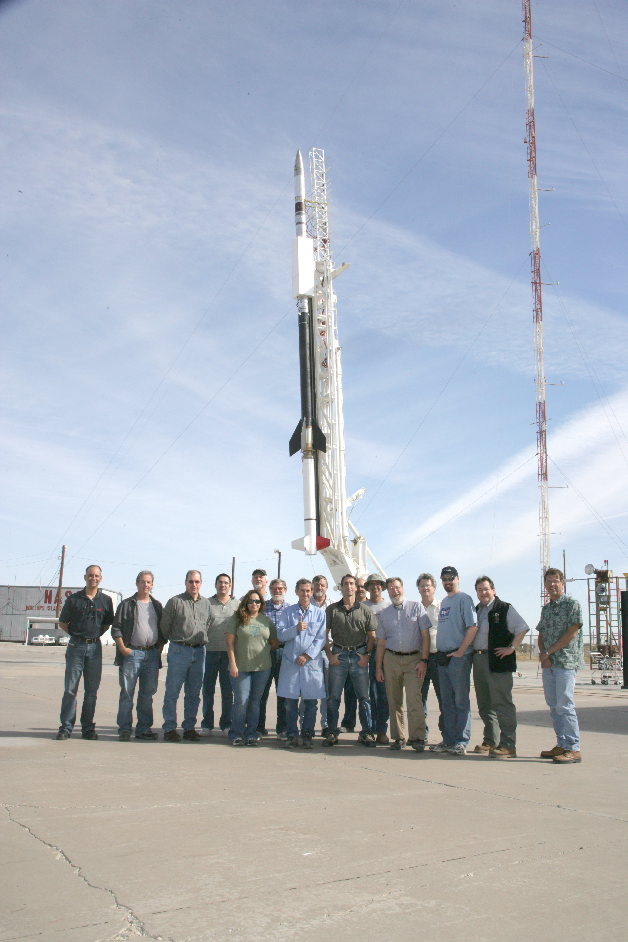
Why a Sounding Rocket?
Sounding rockets are only a faction of the cost of satellites and are able to fly much newer technology.
Flights of sounding rockets such as Eunis also enable the calibration of satellites like SOHO!

Slide 5

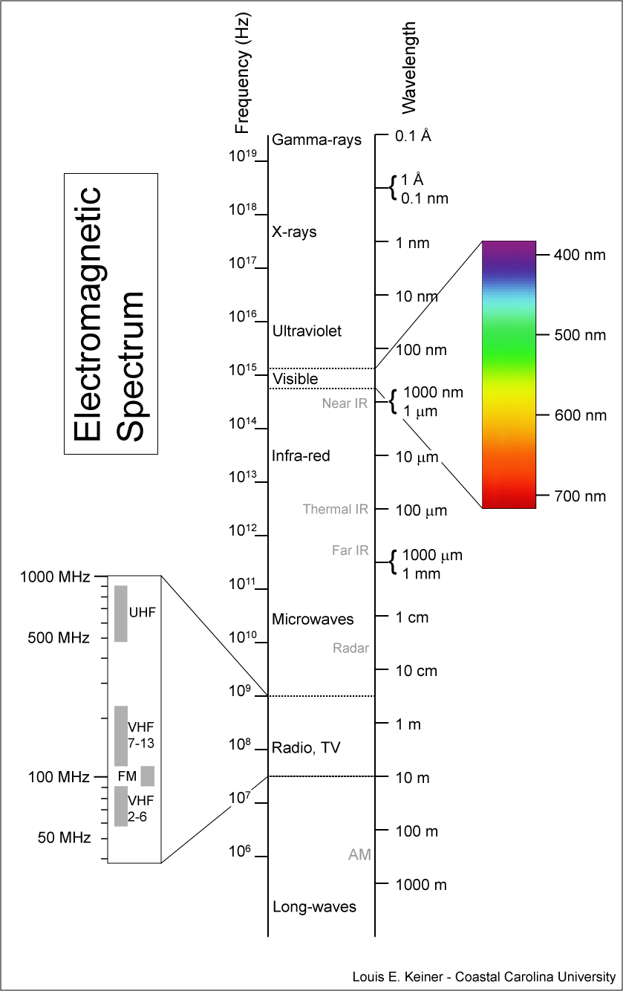

How Eunis Takes Images?

Slide 6
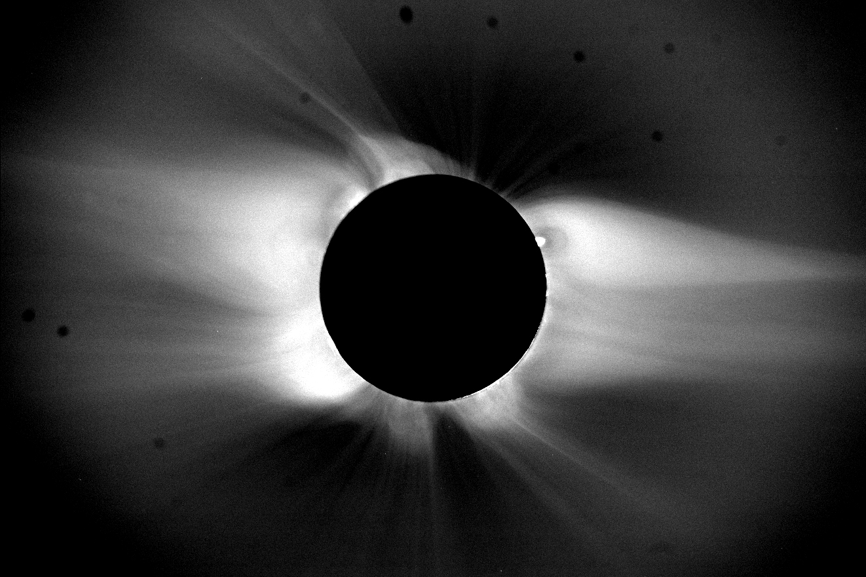

How Eunis Takes Images
microchannel plate
Fiber optics to Active Pixel Sensors

Slide 7
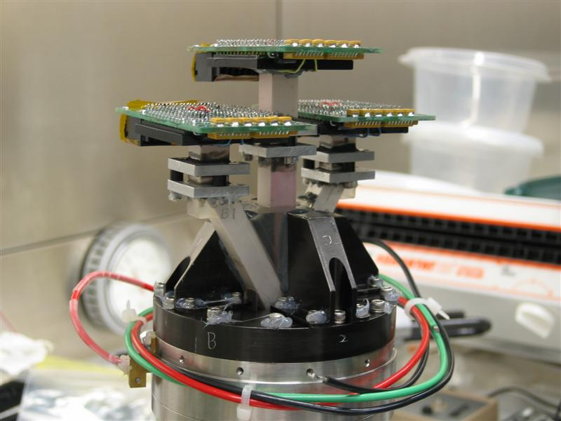
The Detector
Notes:
Microchannel Plate and Active Pixel Sensors
Solar bind EUV -> Photocathode (can’t see visible light)(1stage) -> phosphor on the back that emits a visible green light -> Fiber optics transfer image to active pixel sensors

Slide 8
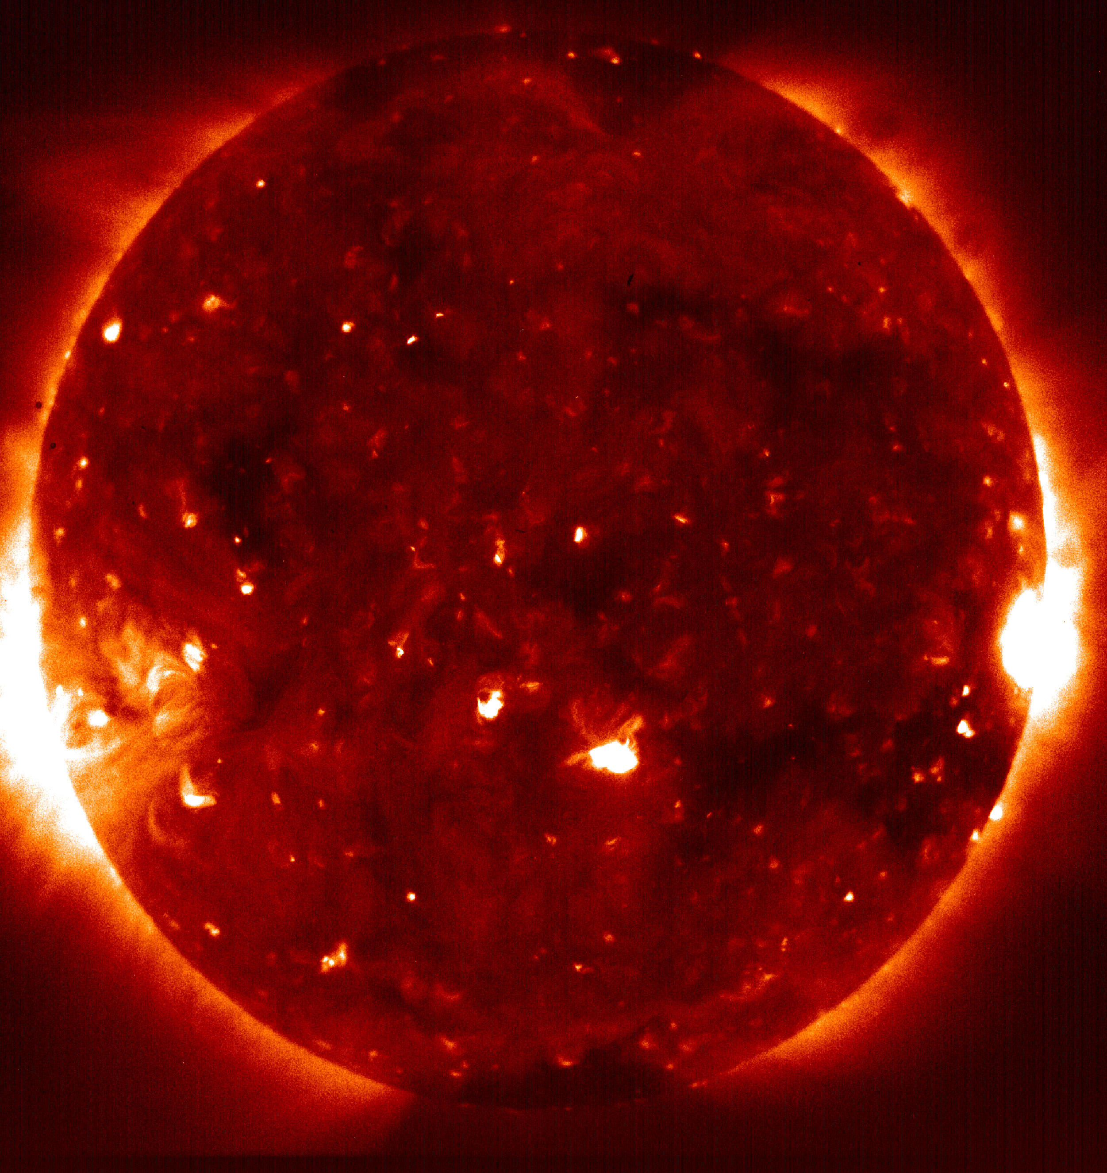
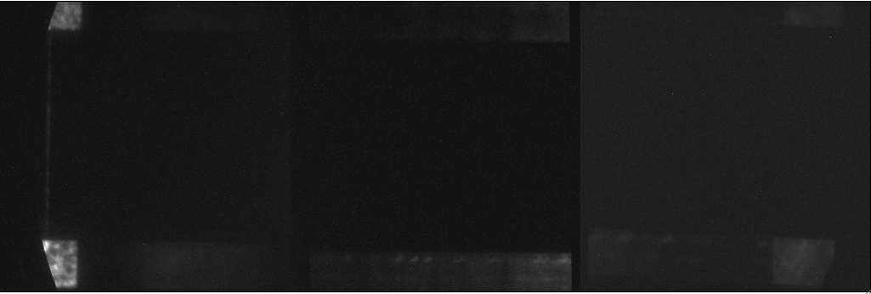
Reduction of Data
Before any kind of analysis can be done on data or it can be used at all it has to be reduce.
Before Reduction

Slide 9


Reduction of Data
I mapped out the reduction process so that for future missions the same reduction procedures and steps could be used more easily.
After Reduction

Slide 10
Example of Reduction Step
Calculates nonlinearity coefficient:
The nonlinearity coefficient is what is produced because the number of photons collected on the detector plate is not completely linear with time of exposure.

Slide 11
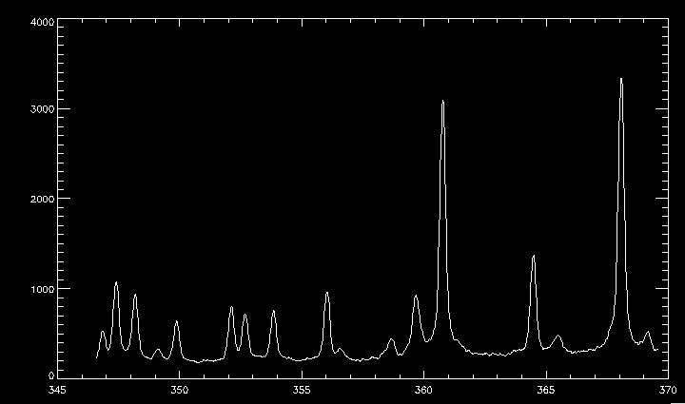
Identifying Spectral Lines
Notes:
921 elements
X = Wavelength (Angstroms)
Y = Amplitude (ergs/cm^2/sec/steradian/Angstrom)

Slide 12


The goal was to find previously unidentified wave lengths.
I fit Gaussian curves to the spectral lines and identified the known wavelengths.
The lines not identified are potentially the lines we are looking for.

Slide 13

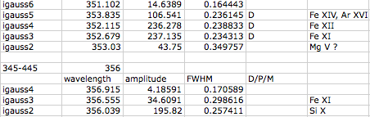
Example of Wavelength List
Notes:
921 elements
Wavelength (Angstroms)
Amplitude (ergs/cm^2/sec/steradian/Angstrom)
FWHM = width(Angstroms = .1nm)

Slide 14
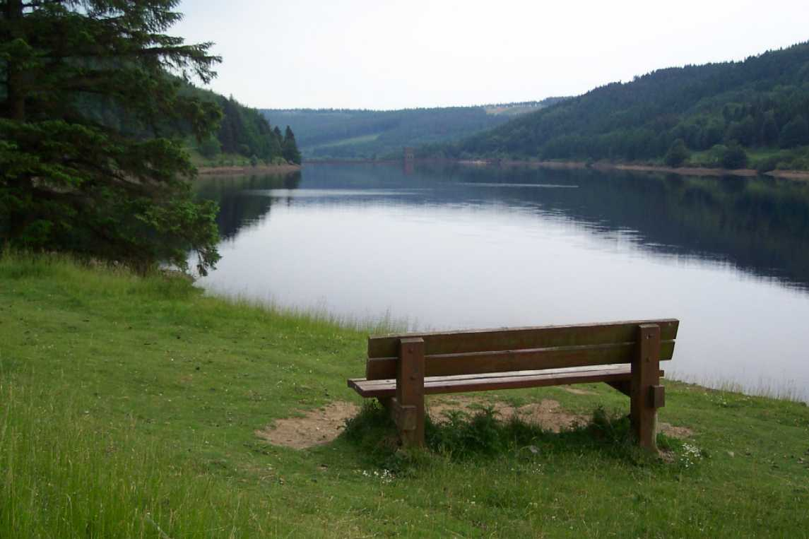
Experience at Goddard
See engineers and scientist doing cutting edge research and construction.
Listen to talks by some of the top scientist in the world.
Learned TONS and TONS about the sun.
……I also go to learn about the true burocracy behind Goddard.

Slide 15
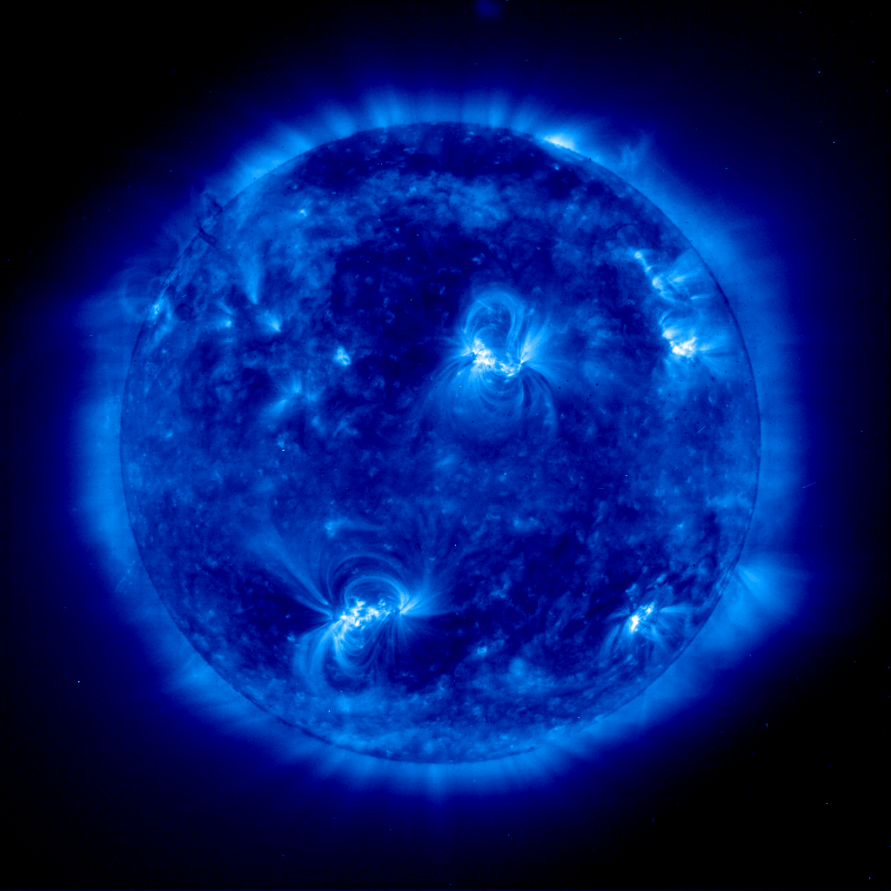
Special Thanks To:
Doug Rabin
Cori Quirk
Roger Thomas
Jeff Brosius
Fred Bruhweiler

